Slide 1

A Visual Journey Through Environmental Crisis
Presented by
S.Sriram

Slide 2
Team Details
Team leader : S.Sriram
Team Member 1: Swathiga S
Team Member 2: DC KHUSHI

Slide 3
Objective
This project “Echoes of Tomorrow “ clearly addresses the importance environmental challenges like deforestation, climate change, and ocean pollution, through AI based application that promotes the emotional visual story by getting the input of image1 (before ) and Image 2 (after) combinations .

Slide 4
Echoes of Tomorrow
The project would use generative AI to create a series of
digital artworks depicting the harmful effects of environmental degradation, leading to awareness and encouraging action.
It could involve a progression of visuals, from scenes of natural beauty to their degradation and eventual destruction, symbolizing the urgent need to protect our planet.

Slide 5
Sample Theme :Deforestation
Scene 1 (Before): A lush, vibrant forest filled with diverse wildlife and greenery. Sunlight filters through the dense canopy, showing nature’s abundance.
Scene 2 (After): The forest is replaced by barren land, with tree stumps scattered across the ground. Animals appear displaced or absent, and the sky looks hazy from distant smoke. This stark contrast highlights the devastating impact of deforestation.

Slide 6
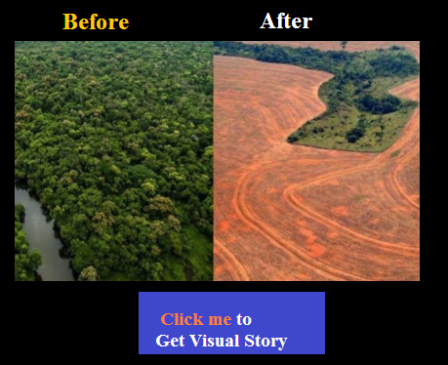
Sample Inputs

Slide 7
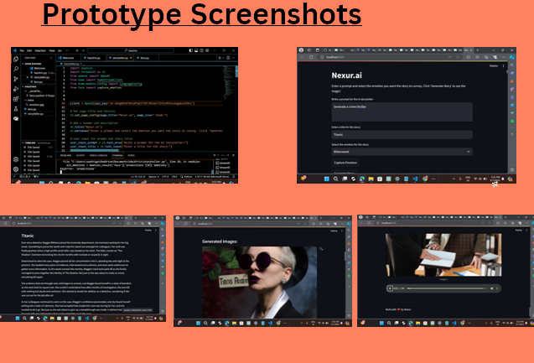
Samples outputs

Slide 8
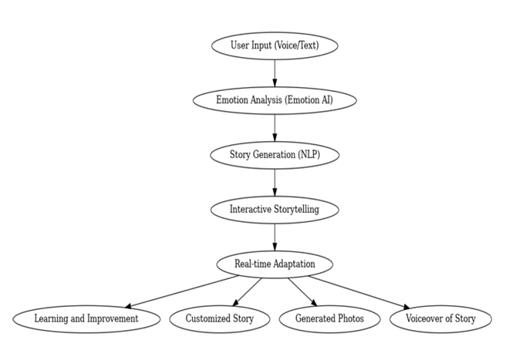
Work flow

Slide 9
Goals
Raising Awareness: By showing both beauty and destruction, you encourage emotional responses, pushing viewers to reflect on their environmental impact.
Inspiring Action: The positive "after" scenes can serve as a hopeful reminder that sustainable solutions can reverse the damage if we act now.
Educational Aspect: You can incorporate brief, impactful facts alongside the visuals to educate the audience about the specific challenges each environment faces.

Slide 10
Visual Storytelling Approach:
Transformation & Deterioration: Each scene would morph slowly from "Before" to "After," allowing viewers to see the progressive impact of human activities. Generative AI can handle this smooth transition, creating an immersive experience.
Symbolic Elements: Include elements like wilting plants, darkened skies, cracked earth, or vanishing animals to symbolize loss. These visuals can be abstract yet emotionally resonant.

Slide 11
Visual Storytelling Approach:
Call to Action: The final part of each series can depict glimpses of hope—reforestation, renewable energy sources, and cleaned-up oceans, showing that change is possible with collective action.

Slide 12
Benefits of Storytelling Application
  Raise Awareness
  Inspire Action
  Emotional Connection
  Positive Solutions

Slide 13
Execution plan:
1.Generative Models: Use AI models to generate landscape art that dynamically shifts in real-time. It could be used to create the "before" and "after" environmental scenes.
2. Interactive Experience: The project could be interactive, allowing viewers to alter the visual scenes. For example, sliding between "Before" and "After" images could simulate the viewer's control over the environment, emphasizing personal responsibility.

Slide 14
Execution plan:
3. Data-driven Art: Use real-world environmental data (e.g., deforestation rates, ocean pollution statistics) to inform the level of degradation in the images, making the artwork not only visual but fact-based.
4. Exhibition/Installation: The project can be displayed as an interactive online platform, in art galleries, or as public installations, where the art can respond in real-time to user engagement..

Slide 15


